Slide 1


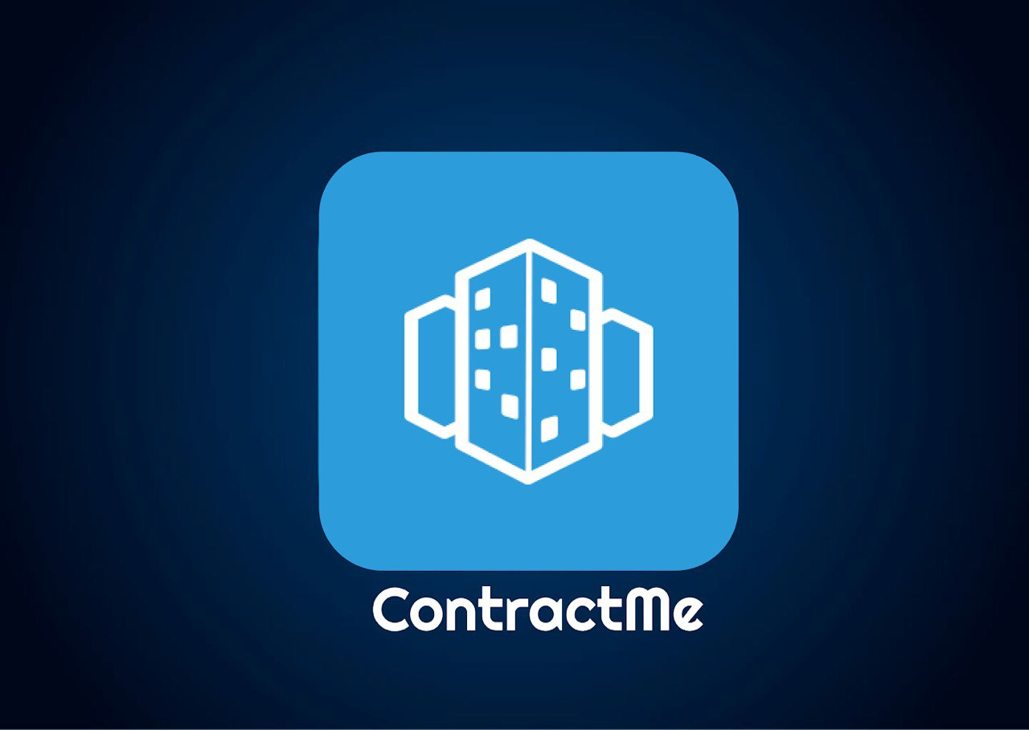
Group 7

Slide 2
Our project
ContractMe is an app that helps connecting between employers and contractors who are registered in the system of a particular human resource company.
The app is easy and convenient for the user and in addition is very effective for finding a job or worker in the high-tech field.
The app is the best solution for HR company workers, employers and contractors because it allows the users to see and track their data in an organized manner.
The process we went through included difficulties like meeting deadlines and filling all the requirements, but after the fact we learned what teamwork is, what is the importance of it and how to deal with the challenges, which we will expand on later.

Slide 3
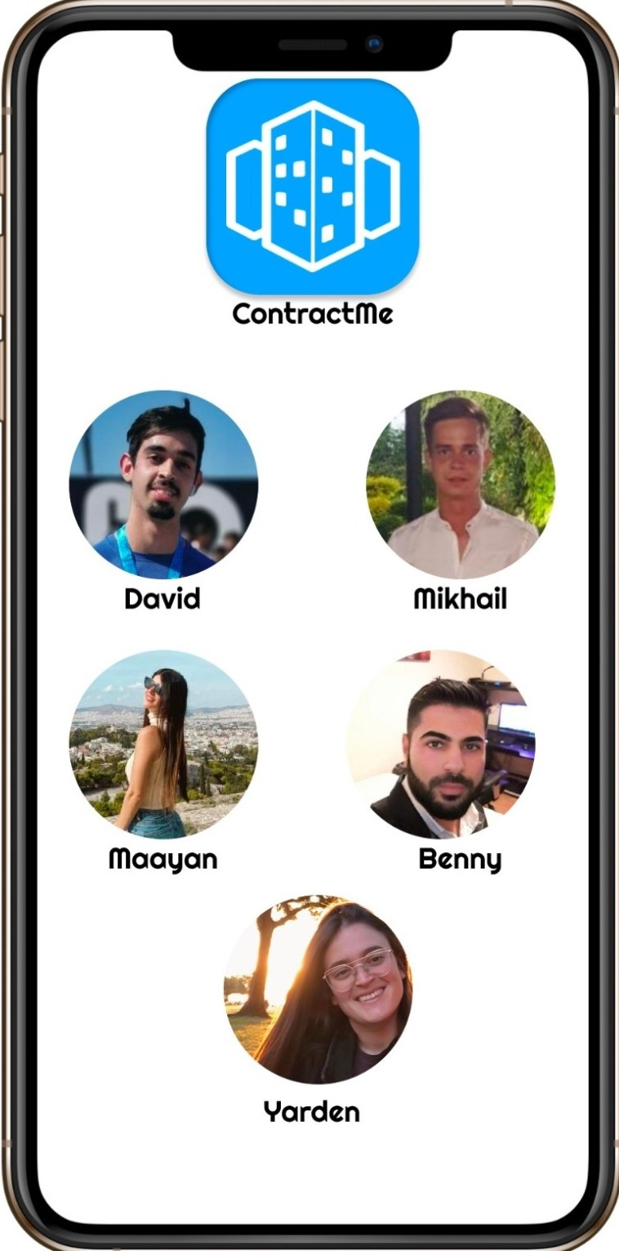
Team members
Yarden Hovav
Maayan Nadivi
David Abenhaim
Benny Shalom
Mikhail Diyachkov

Slide 4

Main functionality and additions
The main functionality in our system is the ability of employers to search for a contractor . The HR workers will be able to follow everything that is done in relation to hiring contractors by the employers.
Contractors can report and track work and vacation days .
In addition, the system has additional functionality that
we have added beyond the customer's requirements,
which is a technical support function, a home button,
and the contractor’s ability to edit his personal details.

Slide 5

Project requirements
The main requirements in our system are that the HR employee will be able to add a new contractor employee to the system, see statistics, a contractor's work history and an employer's employment history and edit a contractor's workdays.
An employer can register to the system, look for a contractor according to his requirements, hire if he finds one that suits him and view his employment history.
A contractor user can view his work history, report a workday or vacation and to see his monthly salary until now .

Slide 6
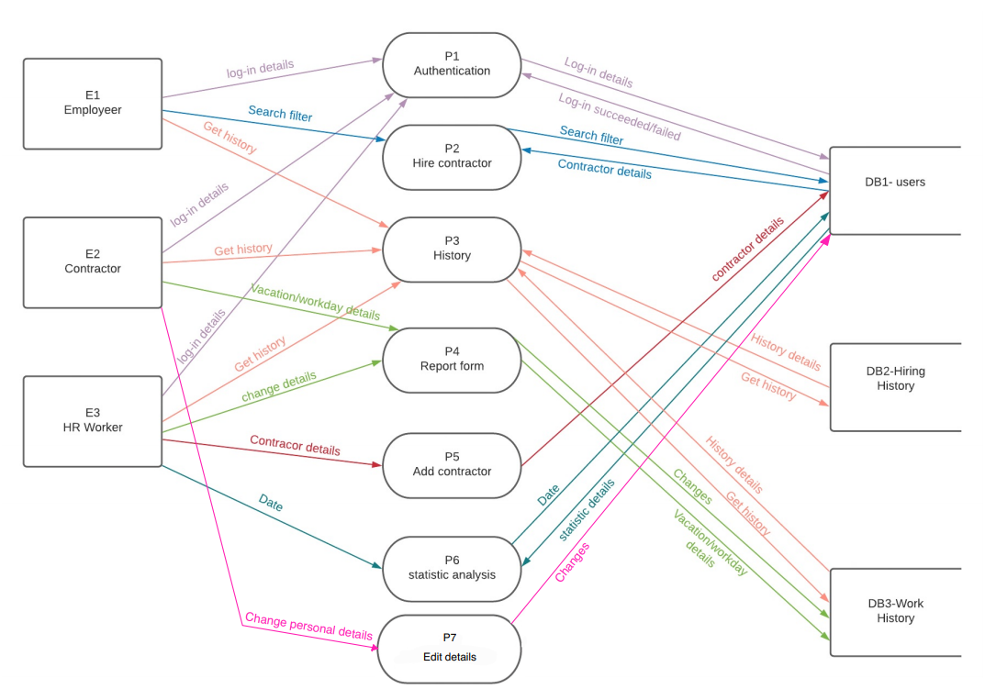
DFD - 0

Slide 7
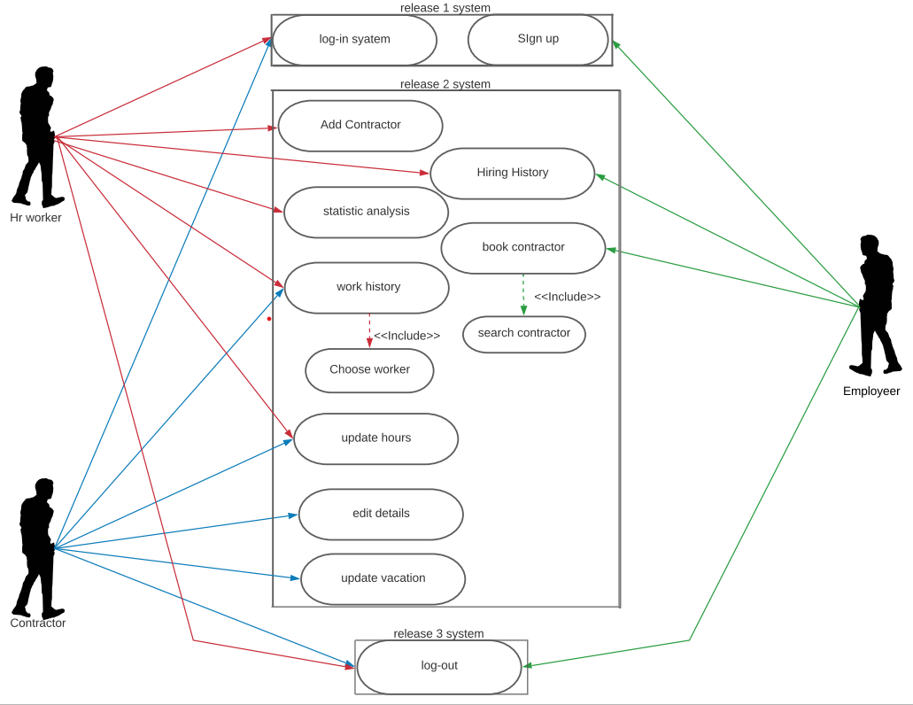
USE - CASE

Slide 8
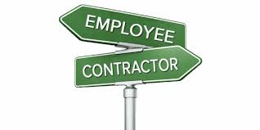
TEST CASES
In the testing process, we examined features of the system, such as: adding a contractor to the system, log-in and log-out from the system, finding a contractor and hiring him and more.
We chose to perform the testing process by dividing the tested features into each of the testing team members.
In the testing process we performed functional tests, system tests, integration tests .
In the testing process we considered number of risks that may occur and what can be done if they occur.
For example: non-compliance with deadlines, unskilled staff, end of pre-allocated budget, sudden absence of one of the
team members and more.

Slide 9

Challenges in the Process
In the process of creating the project we encountered various challenges that we had to face in order to be successful and submit a project in the best way that shows our abilities such as:
Proper understanding of all requirements
The uniqueness of the project.
Scheduling group meetings.
Coordinating expectations .
building the code itself.
Initial dealing with documents that were new to us
Punctuality
Knowing the members of the group - the zoom is difficult to create social connections.

Slide 10
THE END !

